Slide 1

E
AGA
ADVANCED GUIDANCE ASSISTANCE
E
E
ONE UNIT AT A TIME
Lovely Fernandez C2030405696
Technological University Dublin
Computer Science Department

Slide 2
E
INTRODUCTION
E
E

Slide 3
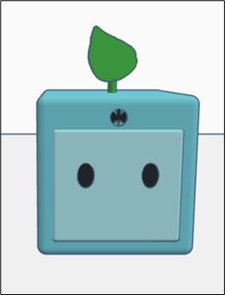
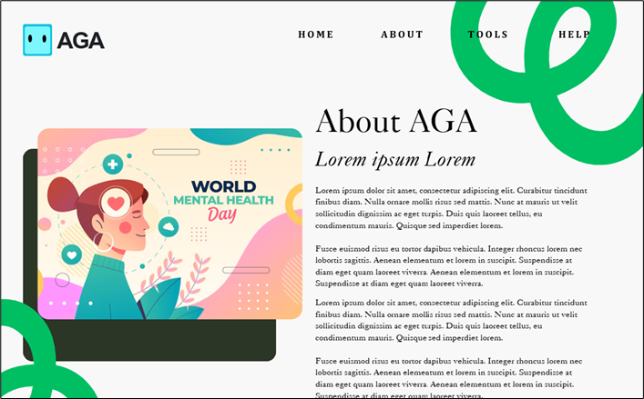
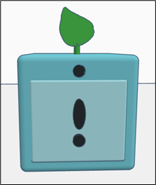
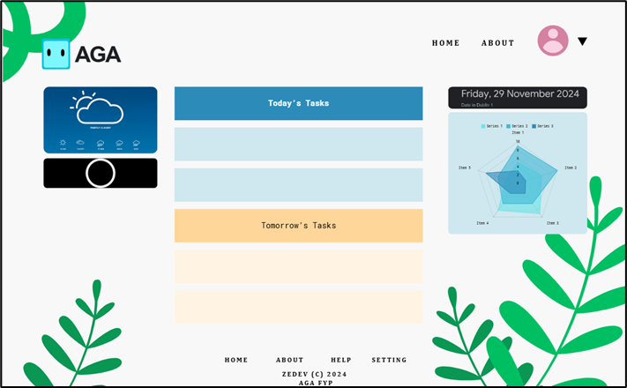
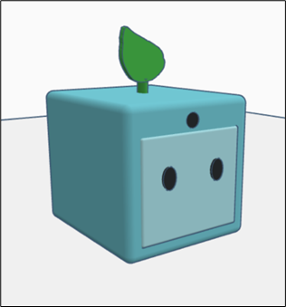
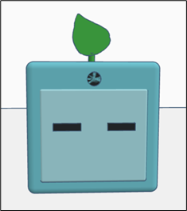
E
AGA
AGAPE
“Unconditional Love”
AGA
Project Overview
AGA is a tool designed specifically to support individuals with ADHD in maintaining a structured, well-balanced lifestyle
E

Slide 4


E
E
AGA
What is ADHD?
“ADHD is considered a chronic and debilitating disorder and is known to impact the individual in many aspects of their life including academic and professional achievements, interpersonal relationships and daily functioning.”
(What Is ADHD?, Psychiatry.org)
Inattentive
Combination
Hyperactive
Focus on Tasks
Restless Behaviours
Forgetfullness
Hyper-fixate
Concentration
Impulsive
Easily Distracted

Slide 5


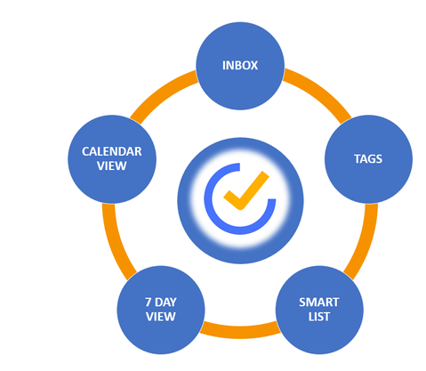
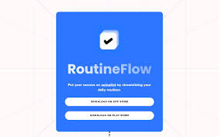
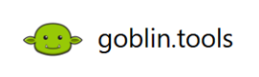
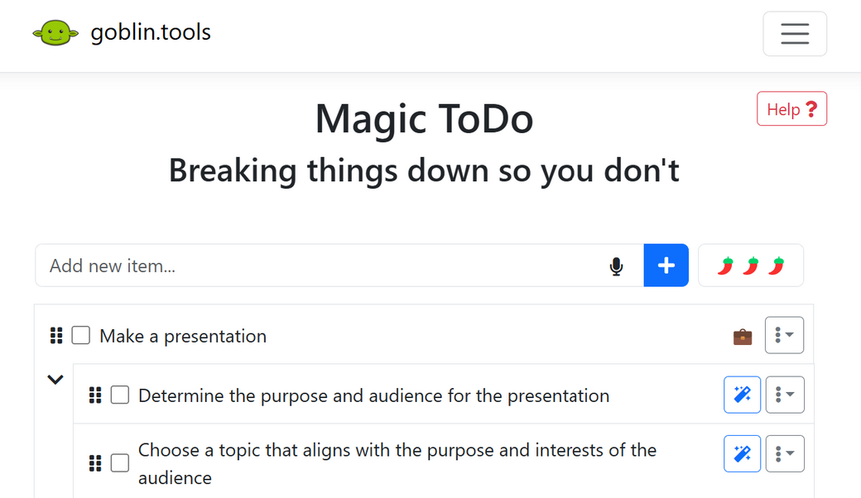
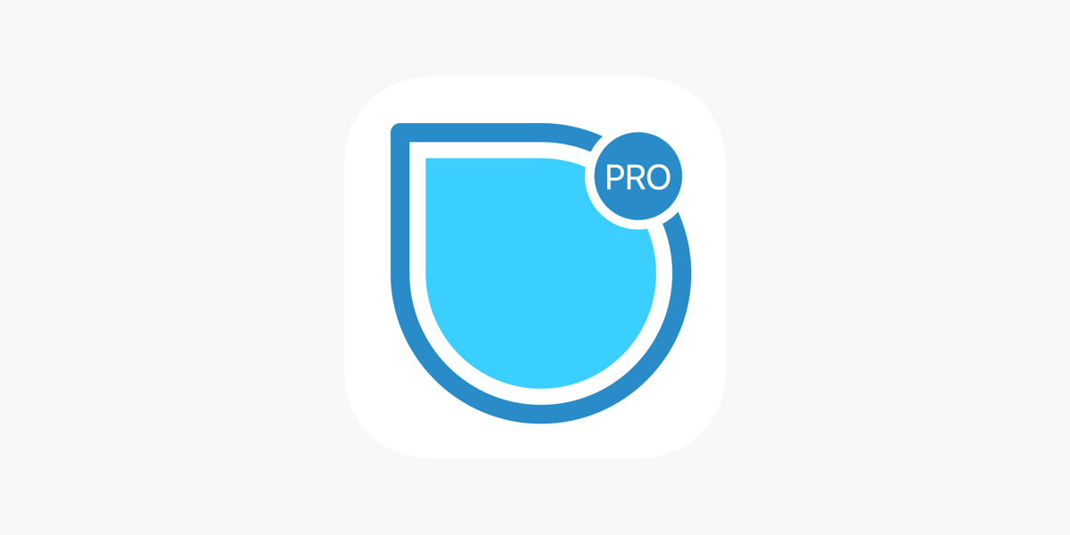
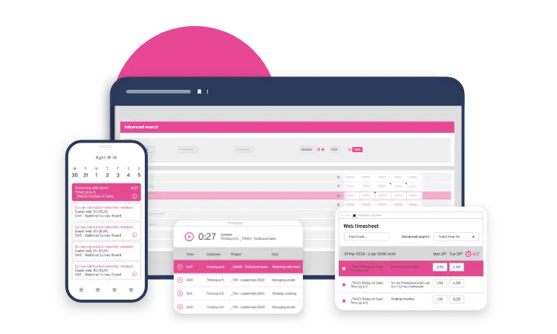
E
E
AGA
Existing Solutions
There is a significant increase in investment for innovative digital health solutions such as Inflow's €2 million funding for an ADHD self-management app in 2022
(UK Founded Inflow Boosted by €2M Raise for ADHD App, 2022)
goblin.tools provides a strong foundation for assisting neurodivergent individuals with task management.

Slide 6
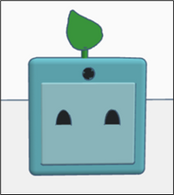
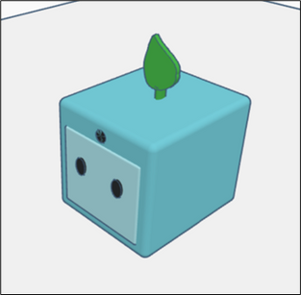
E
AGA
AGA’s Solutions
AGA is a tool designed specifically to support individuals with ADHD in maintaining a structured, well-balanced lifestyle
Focus Mode
Task Setter
Weather Tool
Mood Log
E
Daily Affirmations
Wellbeing Tools

Slide 7
E
DESIGN
E
E

Slide 8





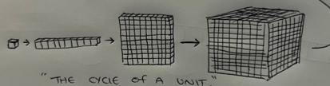


E
AGA
ONE UNIT AT A TIME
Design
Each unit marks the first step toward a goal - starting with one, then ten, then a hundred, then a thousand - ultimately forming a larger whole. This illustrates that each accomplishment is both a milestone and a stepping stone toward an even bigger journey.
E
The concept of units is used to represent the first steps toward a goal which inspires the slogan “One Unit at a Time” where each unit symbolises a step, task, or goal in the individual’s journey.

Slide 9
E
DEVELOPMENT
E
E

Slide 10
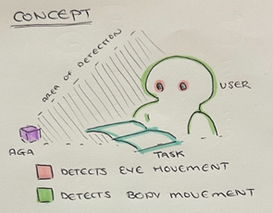
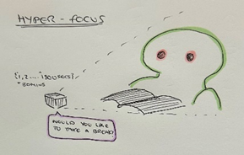
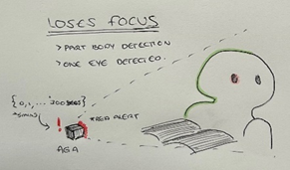
E
E
AGA
Focus Mode
A concentration device that alerts users when they lose focus on a task or, if it senses signs of intense focus, recommends taking break.
Detects User’s Eyes, Head, and Body Movements
User engages with task for an extended period
User loses focus of the task
AGA alerts user to return to the task
AGA notifies user to take a break
Timer begins when Focus Mode is enabled

Slide 11
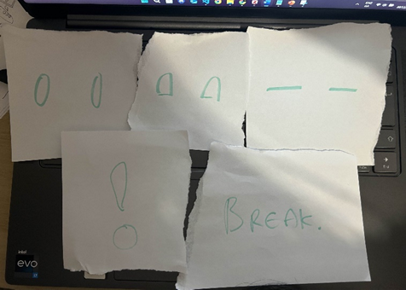
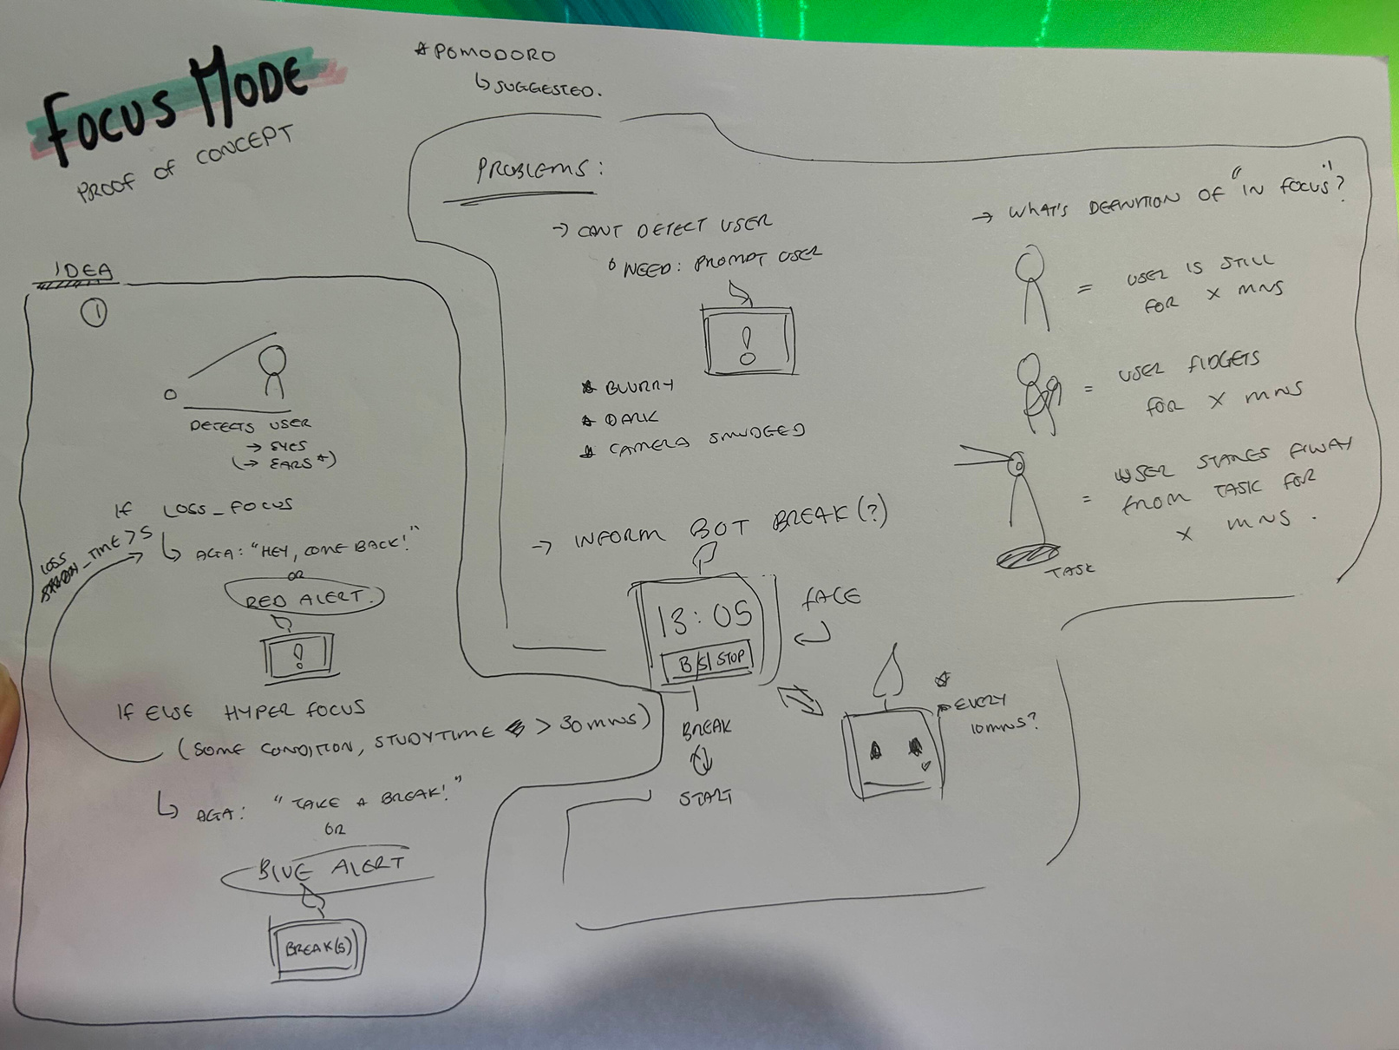

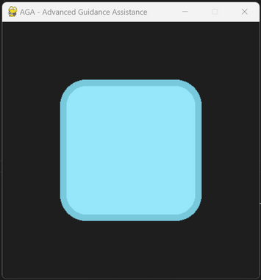
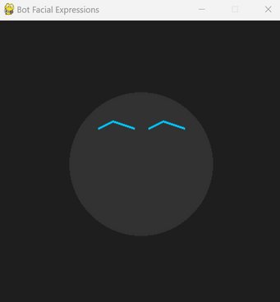
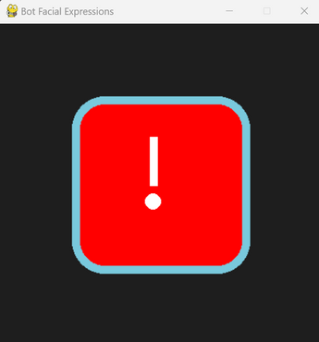

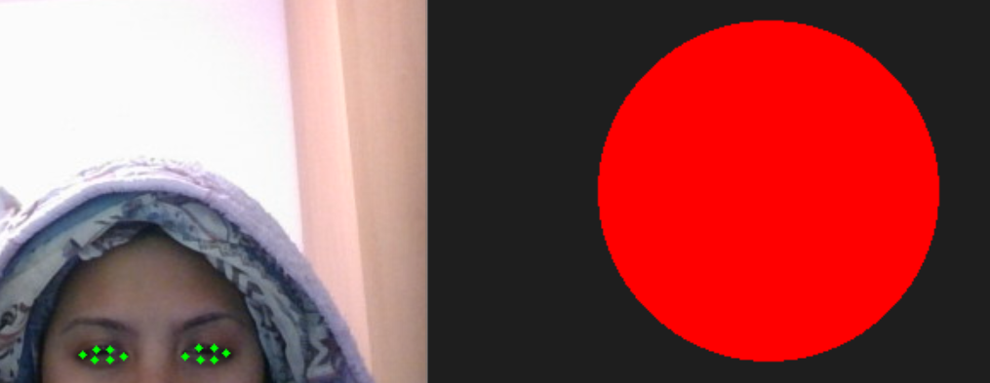
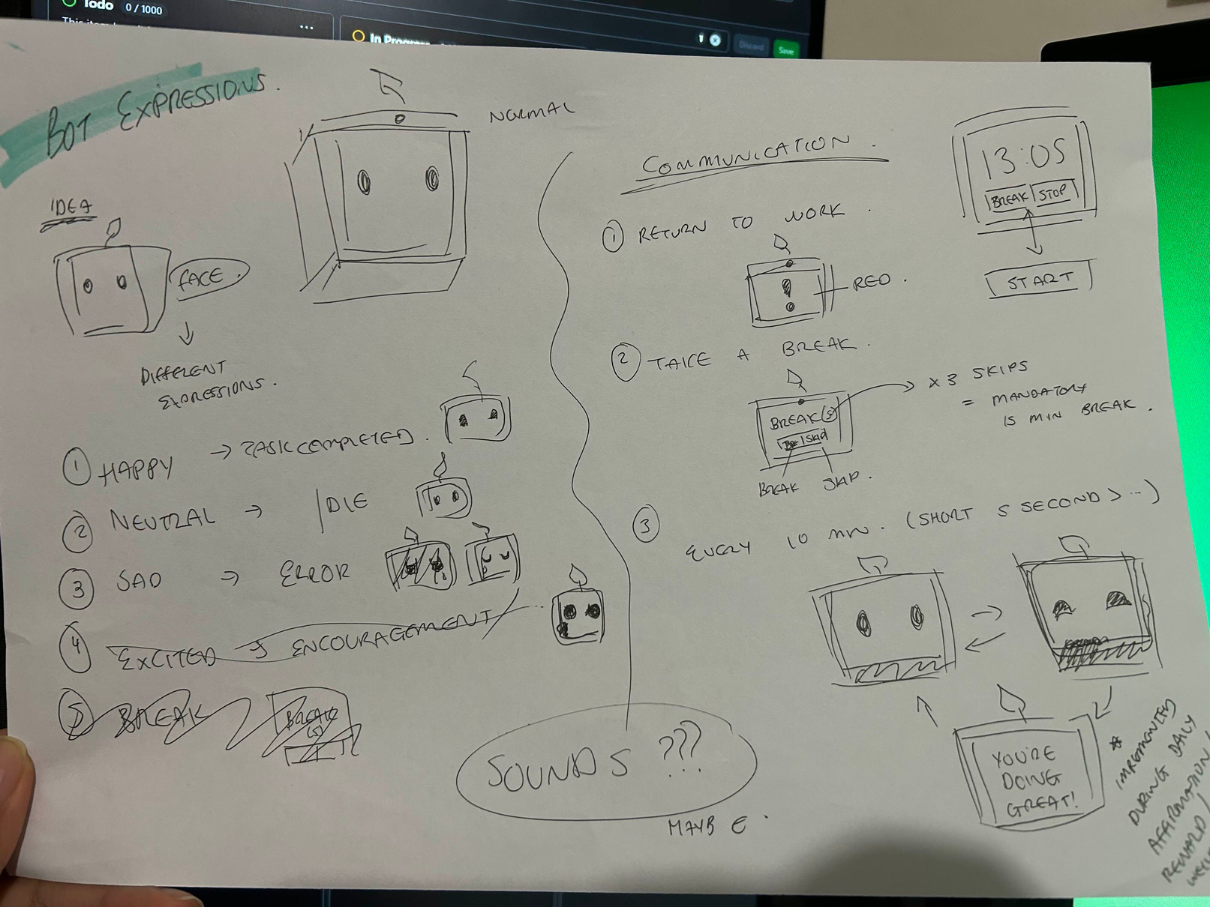

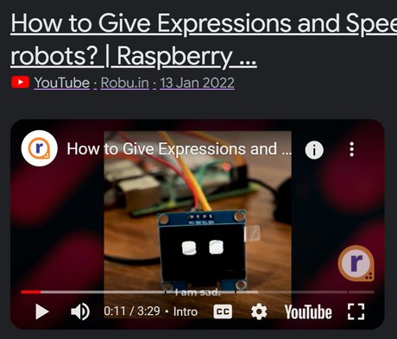
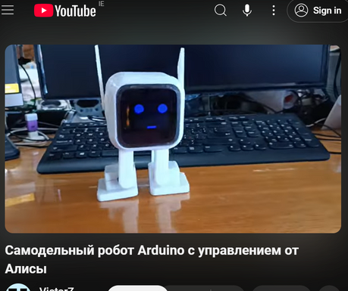
E
E
AGA
Implementation
Building AGA with Focus Mode
Challenges?
1. Detecting User
2. Create Bot Expressions
3. Integrating both
4. Doubts about AGA

Slide 12
E
FUTURE PLAN
E
E

Slide 13

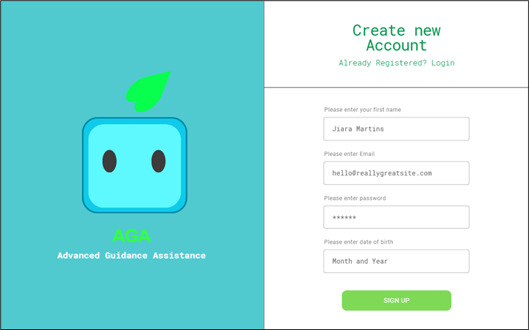
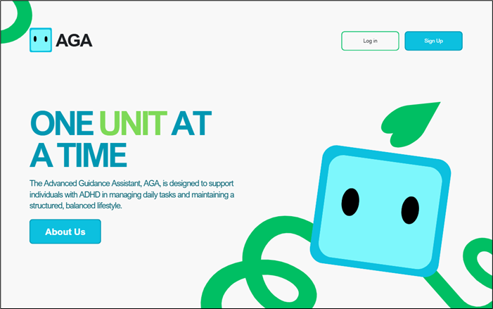
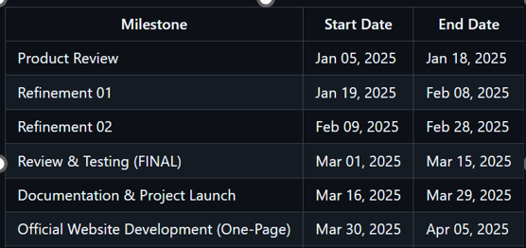
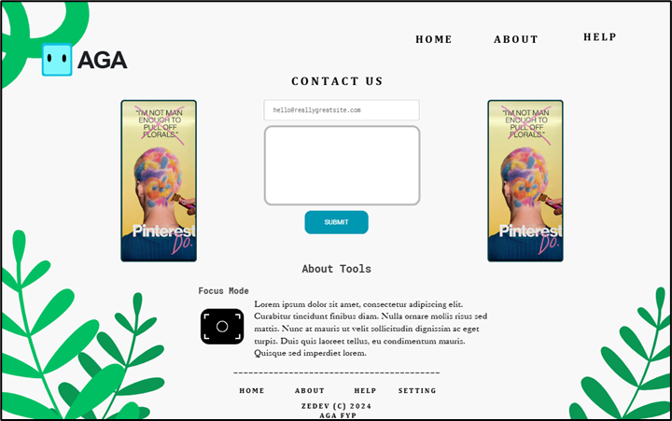
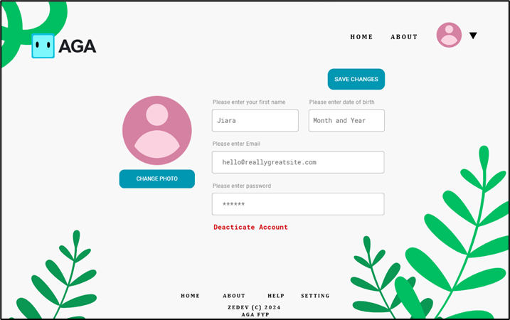
AGA
Future Scope
ONE UNIT AT A TIME
Implementation
Web App
Implementation
AGA
Task Setter
Focus Mode:
End of Year
Mood Log
Clock
Weather Tool
Accurate Time
Account/Profile
Start, Stop, Pause
Next Year

Slide 14
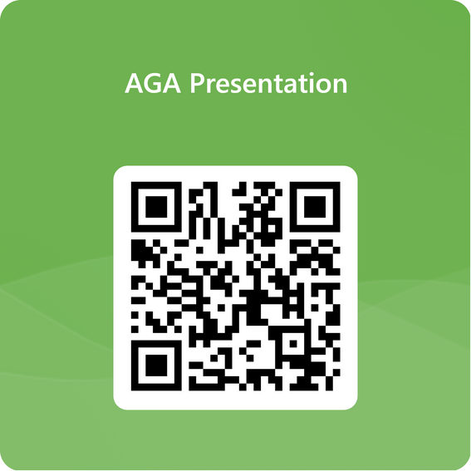
E
E
THANK YOU
I hope you have a nice day!
Lovely Fernandez C2030405696
c20305696@mytudubline.ie
Technological Univeristy Dublin
School of Computer Science Central Quad

Slide 15
E
DEMO
E
E

